Slide 1
Use Cases Testing Refactoring and Regression
C4045

Slide 2
Test Driven Design
OK you are learning Scrum which is an incremental development process
You are implementing a game in Unity
Each stage of this should involve
Testing
Both your own – alpha tests
Others – beta tests
And Gamma tests – once deployed to some “canary” customers
If you were Microsoft or Apple all your customers would be “Canaries”

Slide 3
Test Driven Design
Design will start with testing
Through use of paper based or other low or mid fi prototypes
Not my job here to talk about these
When you get to the start of coding you start with code tests
Unit Testing starts with the smallest part of your product
Say we need a class to store the results of a players actions

Slide 4
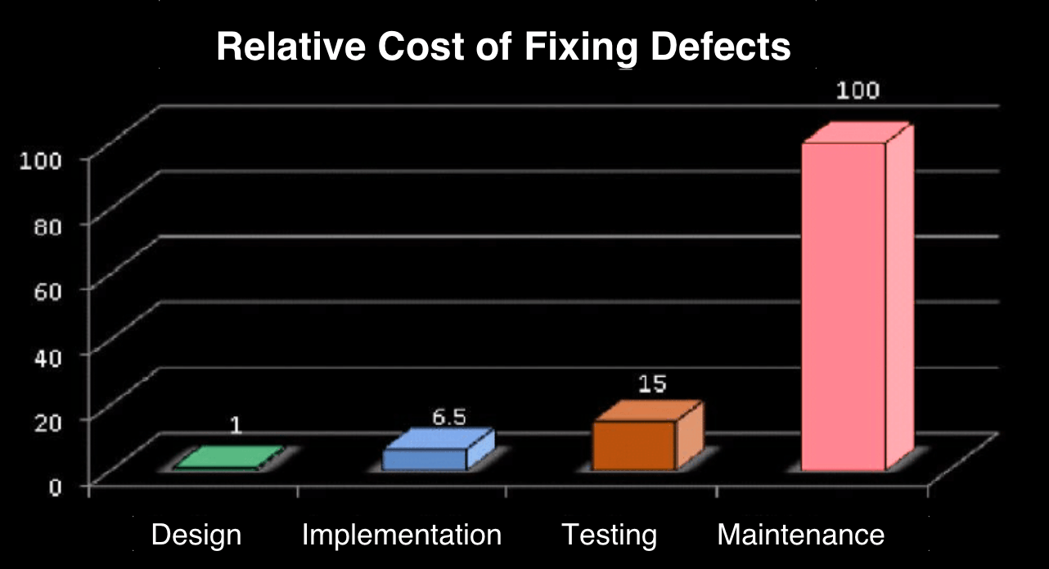
Test Driven Design
The earlier you find bugs and fix them the lower the cost
https://letsmakeagame.net/unity-unit-testing-basics-tutorial/
To quote this page:
Unit Testing can reduce the defect rate.
Plus, the sooner you catch the bug, the cheaper it is.
This is a page on Unit Tests in Unity

Slide 5
OK we need to display the performance to players
Score
High Score
Total
Time
Best Time

Slide 6
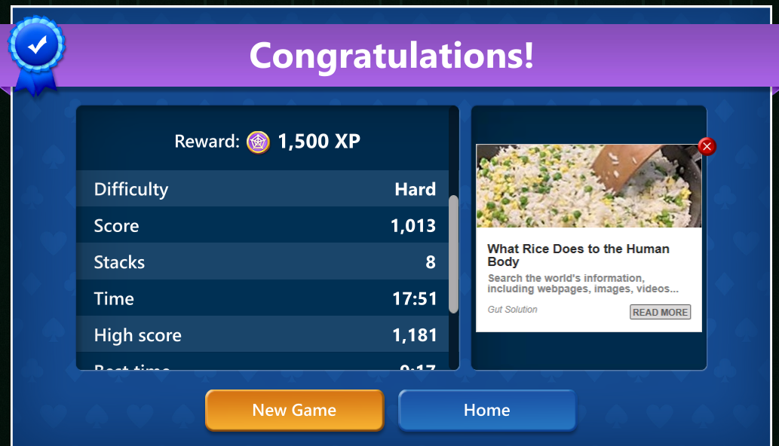
We need a “Lo fi” Prototype
Basing this on an example from the Microsoft Solitaire
Your Progress
Score 10
High Score 100
Total 500
Time 14:30
Best Time 9:10
Advert Goes Here

Slide 7
A Use Case
My Backlog comes from the user story for a version of a Snakes and Ladders Game
Board
Square
Counter
…
Each one has at least one use case
I have done the board
What about keeping score

Slide 8
The ScoreSummary class
We can make a set of Unit Tests
We know we are going to have
Score
High Score
Total
Time
Best Time
What would the Constructor look like

Slide 9
Use Cases to Test Cases
Each use case leads to a text case
ScoreSummary exists
So let us start a Unit Test system
I will go straight to Visual Studio
But you can start these from Unity
See the example tutorial
https://letsmakeagame.net/unity-unit-testing-basics-tutorial/

Slide 10
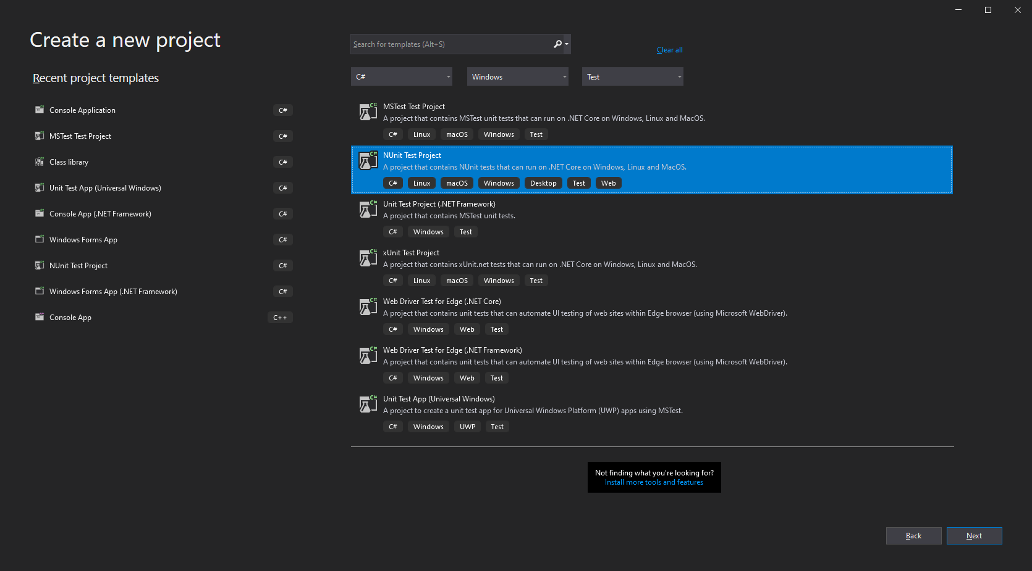
In VS 2019

Slide 11
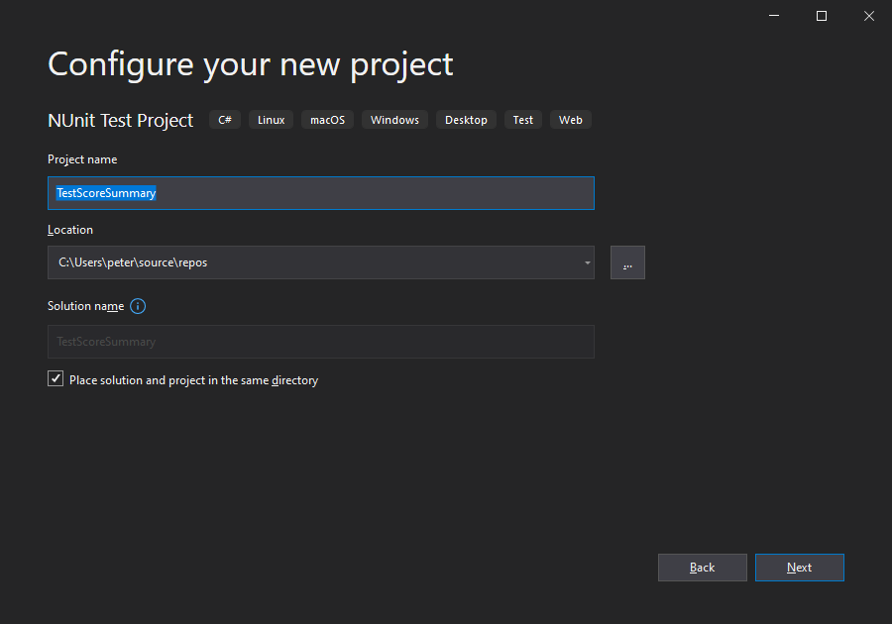

Slide 12
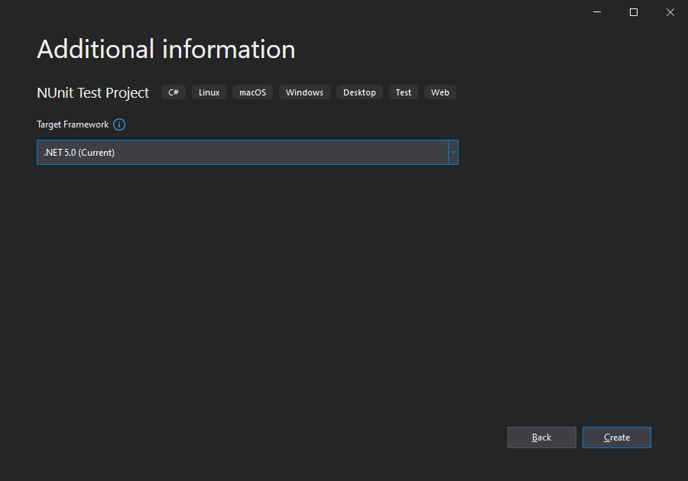
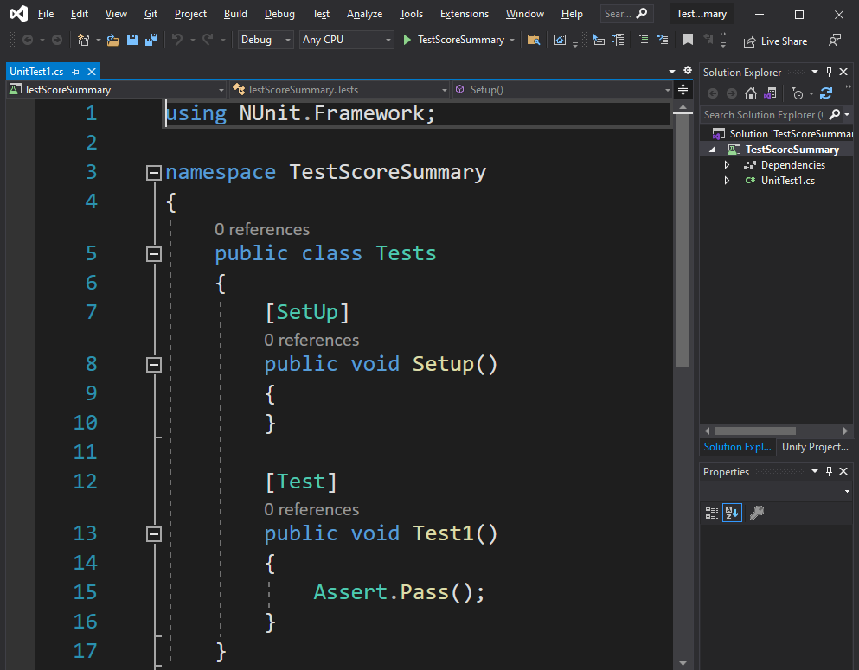
There should also be a TearDown
Set Up is Run First to set things up
Then the Tests
Then Tear Down to delete thigs you will not need

Slide 13
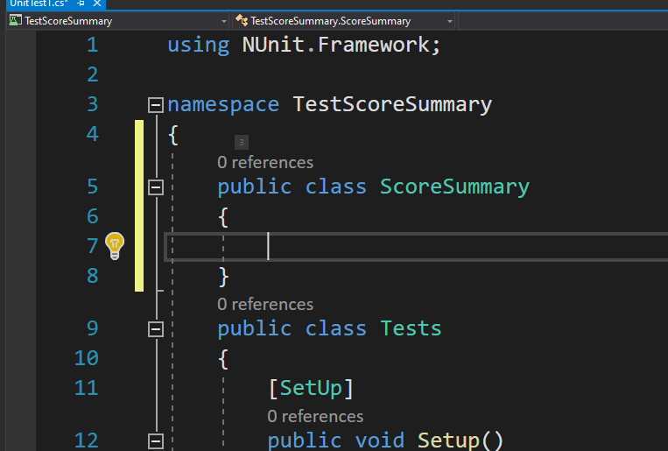
Done properly you get the system to create the Class as a Separate thing
You will be able to set up a namespace for it
Create a DLL
And add it to your game
But for now

Slide 14
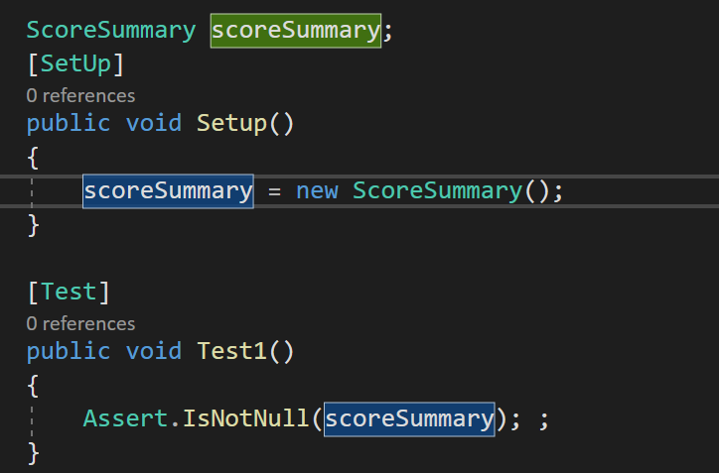
First Test

Slide 15
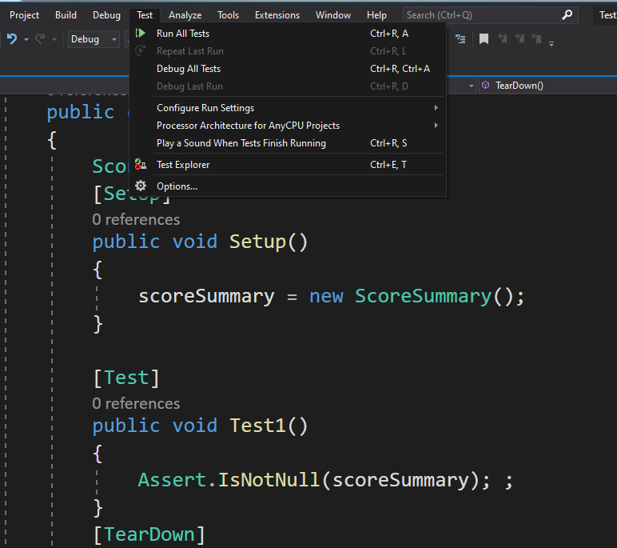
Run the tests

Slide 16
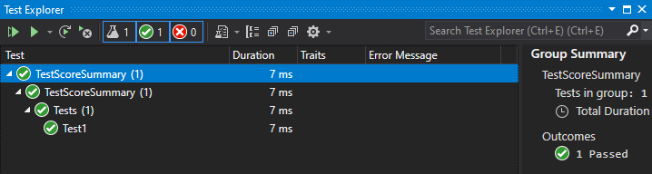
It Passes

Slide 17
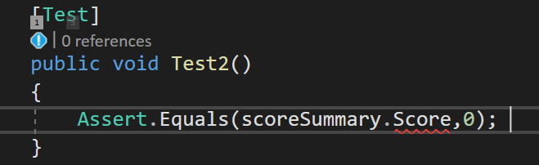
A simple class
But it does not store anything
Need to add the fields
Can Assert
Score equal to 0!
But we get a red squiggle
Get the options
Create a Score parameter

Slide 18
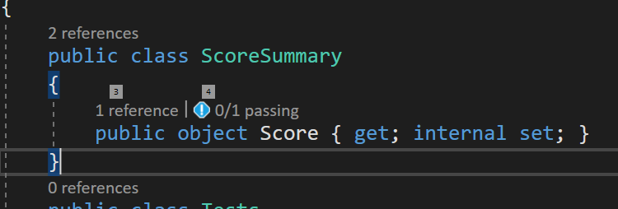
A simple class
But it does not store anything
Need to add the fields
Can Assert
Score equal to 0!
But we get a red squiggle
Get the options
Create a Score parameter

Slide 19
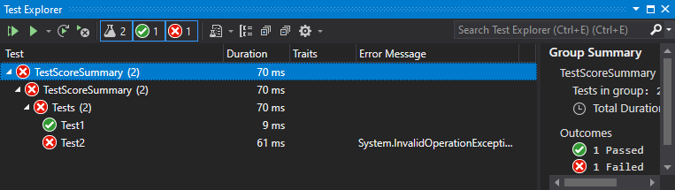
Run the tests
It fails

Slide 20
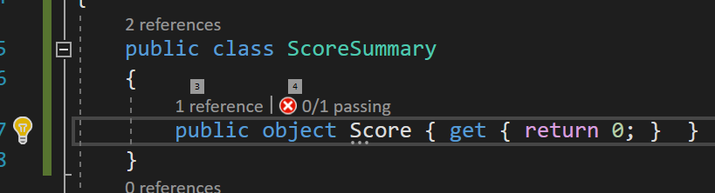
Make the test Pass
Like so

Slide 21
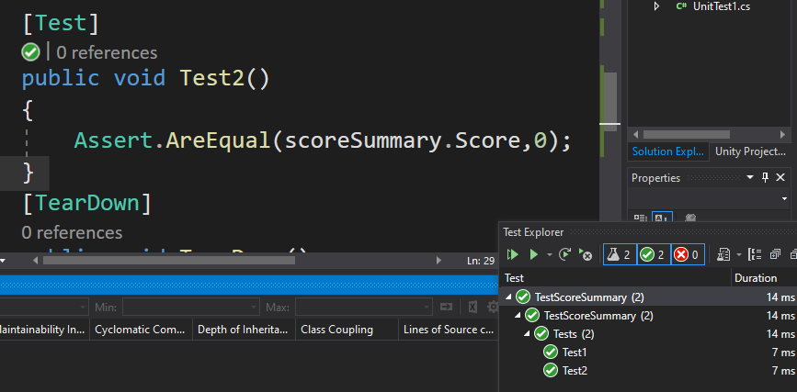
And so

Slide 22
And so what if we read a score

Slide 23
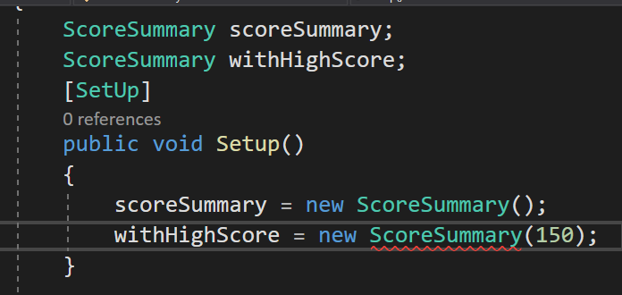
We may read scores from a file or database
So High score is known when we construct the object
We need to refactor the code so that we have a constructor with a high score value

Slide 24
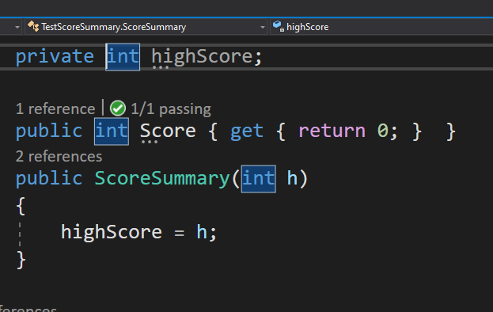
We make this work
But Previous test now have errors
Regression tests Fail!
(Previous tests)

Slide 25
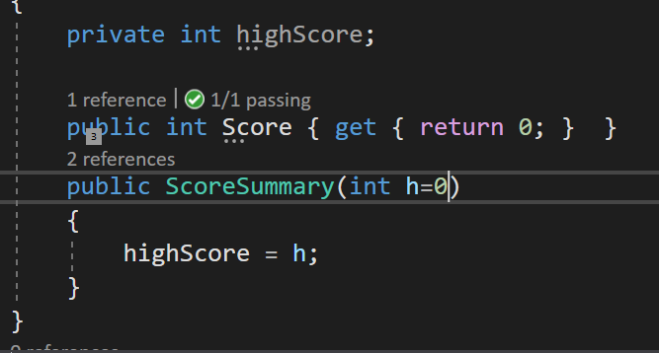
Easily refactored
Now we need a test for High Score

Slide 26
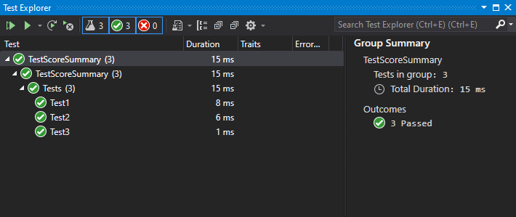
Next Test
Steadily all tests pass

Slide 27
Some things best tested in Unity
Open Unity and include your class to the project
I cheated a bit
I made a ScoreSummary class in Unity
Then added what was made so far as a sub class ScoreSummaryTested
I also want to test read some data from a file
But first I wrote some data to the file
So I knew I could find it

Slide 28
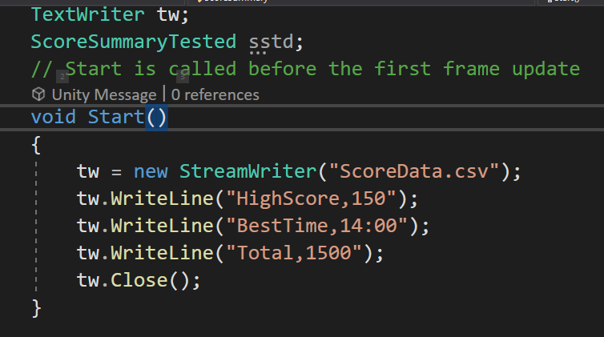
The code to write to file

Slide 29
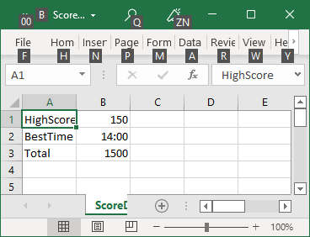
The data in the file opens in Excel

Slide 30
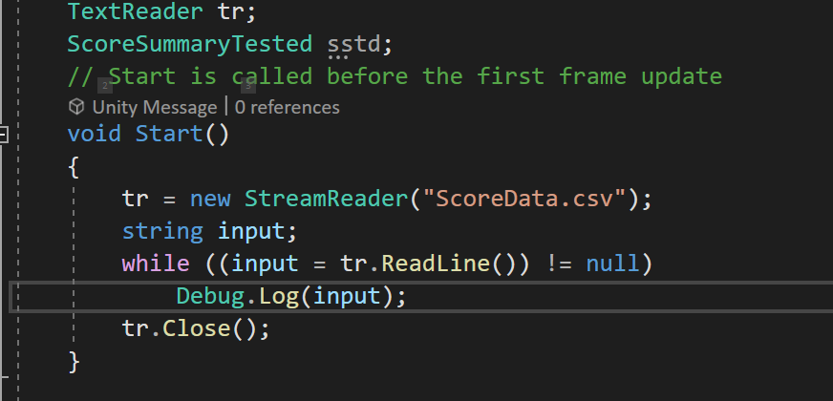
I can now write a new test It uses the Debug Log

Slide 31
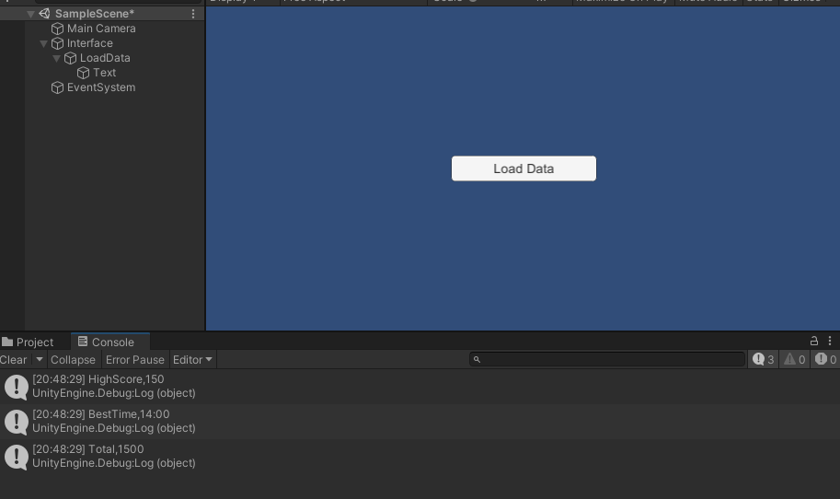
Save and Run
The Debug logs to the Console in Unity

Slide 32
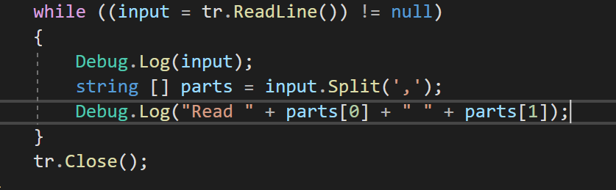
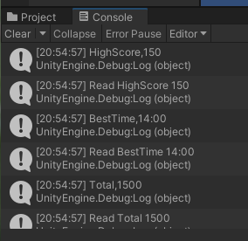
So now we need to split the data up
And That Passes

Slide 33
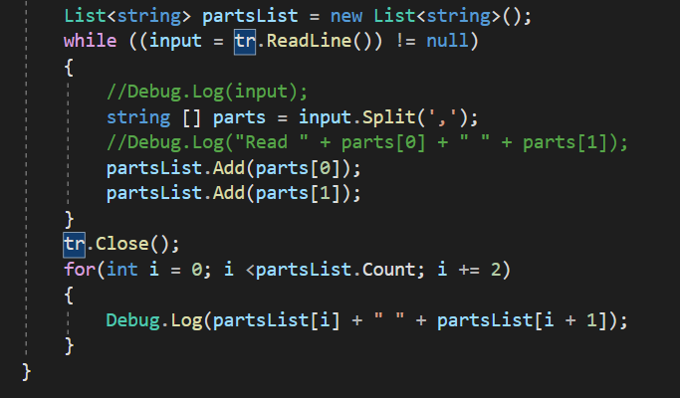
I’m going to need to save the data so I can run regression tests
Currently commenting out my recent regression tests so I can see the new ones in the Console window

Slide 34
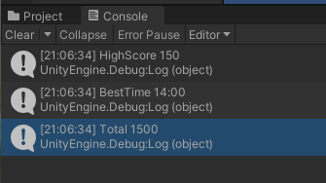
Result

Slide 35
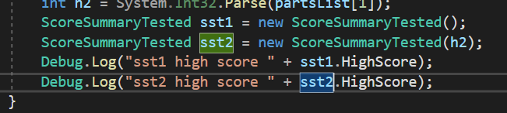
Now for my regression tests of earlier tests
We should be able to make a default ScoreSummary and
one where we construct with a value
In both cases the correct HighScore should be returned

Slide 36
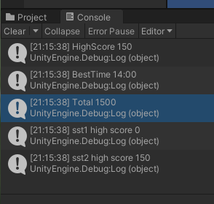
Now for my regression tests of earlier tests
Both regression tests pass

Slide 37
More refactoring needed!
We need to add
More values to the constructor
For the Best Time
And the Total
And …

